Slide 1
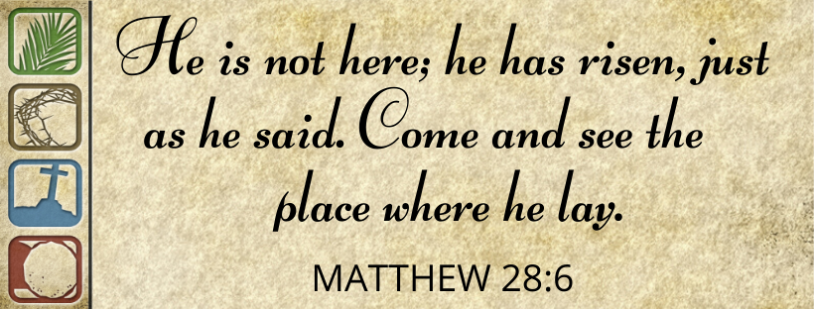

Slide 3
Resurrection account in Matthew 28
Four Perspectives on Resurrection Sunday

Slide 4
Matthew 28:1-20
After the Sabbath, at dawn on the first day of the week, Mary Magdalene and the other Mary went to look at the tomb.
2 There was a violent earthquake, for an angel of the Lord came down from heaven and, going to the tomb, rolled back the stone and sat on it. 3 His appearance was like lightning, and his clothes were white as snow. 4 The guards were so afraid of him that they shook and became like dead men.
5 The angel said to the women, “Do not be afraid, for I know that you are looking for Jesus, who was crucified. 6 He is not here; he has risen, just as he said. Come and see the place where he lay. 7 Then go quickly and tell his disciples: ‘He has risen from the dead and is going ahead of you into Galilee. There you will see him.’ Now I have told you.”

Slide 5
8-10 The women, deep in wonder and full of joy, lost no time in leaving the tomb. They ran to tell the disciples. Then Jesus met them, stopping them in their tracks. “Good morning!” he said. They fell to their knees, embraced his feet, and worshiped him. Jesus said, “You’re holding on to me for dear life! Don’t be frightened like that. Go tell my brothers that they are to go to Galilee, and that I’ll meet them there.”
11-15 Meanwhile, the guards had scattered, but a few of them went into the city and told the high priests everything that had happened. They called a meeting of the religious leaders and came up with a plan: They took a large sum of money and gave it to the soldiers, bribing them to say, “His disciples came in the night and stole the body while we were sleeping.” They assured them, “If the governor hears about your sleeping on duty, we will make sure you don’t get blamed.” The soldiers took the bribe and did as they were told. That story, cooked up in the Jewish High Council, is still going around.

Slide 6
16-17 Meanwhile, the eleven disciples were on their way to Galilee, headed for the mountain Jesus had set for their reunion. The moment they saw him they worshiped him. Some, though, held back, not sure about worship, about risking themselves totally.
18-20 Jesus, undeterred, went right ahead and gave his charge: “God authorized and commanded me to commission you: Go out and train everyone you meet, far and near, in this way of life, marking them by baptism in the threefold name: Father, Son, and Holy Spirit. Then instruct them in the practice of all I have commanded you. I’ll be with you as you do this, day after day after day, right up to the end of the age.”

Slide 7
Christmas
Christmas is when the story starts.
Good Friday
The first phase in our redemption. Jesus stepped in as our substitute to pay our fine—all so that we could be reconciled with God the Father.
Resurrection Sunday
When Jesus resurrected from death. Since he overcame death, we have reason to believe he can do the same for us.
Pentecost
The beginning of a new story. Fifty days after Easter Sunday, the Holy Spirit descends upon the Apostles and other followers of Jesus in Jerusalem

Slide 8
Accepting Christmas doesn’t make you a Christian.
But Easter is a different story.
It sets Christianity apart from all other religions.
It sits at the heart of our Christian faith.

Slide 9
Four perspectives of Easter
The history of Easter – Did it really happen?
The theology of Easter – Jesus is risen. He is up where he belongs.
The hope of Easter – Jesus is risen! We can be up where we belong!
The celebration of Easter – Jesus is risen! I am up where I belong!

Slide 10
1. History –
DID IT REALLY HAPPEN?

Slide 11
1. History – Did it Happen?
What day?
Most Christians celebrate Jesus’ resurrection during the Easter period.
According to the Bible, Jesus‘ death and resurrection occurred at the time of the Jewish Passover
celebrated on the first Full Moon following the vernal equinox.
In 325, the Council of Nicaea established that Easter would be held on the first Sunday after the first Full Moon occurring after the vernal equinox.

Slide 13
1. History – Did it Happen?
The real question – did Jesus actually rise from the dead?
Skeptical theories generally fall into four groups:
Wrong tomb
Mary and Mary and the Disciples were seeing things
1 Corinthians 15:3-8, Paul lists people who saw the risen Jesus. These witnesses include Peter, James and more than 500 others.
Jesus fainted (did not actually die)
The body was stolen

Slide 14
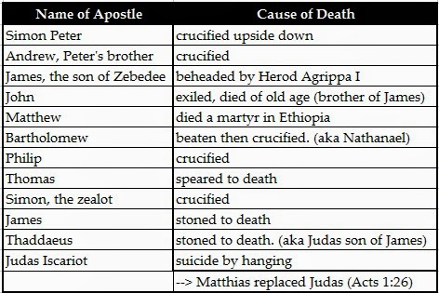
Greatest proof is the lives of the apostles

Slide 15
2. Theology – Jesus is risen. He is where HE BELONGS
What does IT mean?

Slide 16
2. Theology – Jesus is risen. He is where HE BELONGS
He was God(’s son) in human form.
He has returned (ascended into heaven).
He intervenes (intercedes) for us.

Slide 17
2. Theology – Jesus is risen. He is where HE BELONGS
1 Timothy 3:16 (the message)
This Christian life is a great mystery, far exceeding our understanding, but some things are clear enough: He appeared in a human body, was proved right by the invisible Spirit, was seen by angels. He was proclaimed among all kinds of peoples, believed in all over the world, taken up into heavenly glory.

Slide 18
Romans 8:32-34 – the old and the new
He who did not spare his own Son, but gave him up for us all—how will he not also, along with him, graciously give us all things? ³³ Who will bring any charge against those whom God has chosen? It is God who justifies. ³⁴ Who then is the one who condemns? No one. Christ Jesus who died—more than that, who was raised to life—is at the right hand of God and is also interceding for us.
If God didn’t hesitate to put everything on the line for us, embracing our condition and exposing himself to the worst by sending his own Son, is there anything else he wouldn’t gladly and freely do for us? And who would dare tangle with God by messing with one of God’s chosen? Who would dare even to point a finger? The One who died for us—who was raised to life for us!—is in the presence of God at this very moment sticking up for us.

Slide 19
3. Hope – Jesus is risen! We can be up where WE BELONG
WHY?

Slide 20
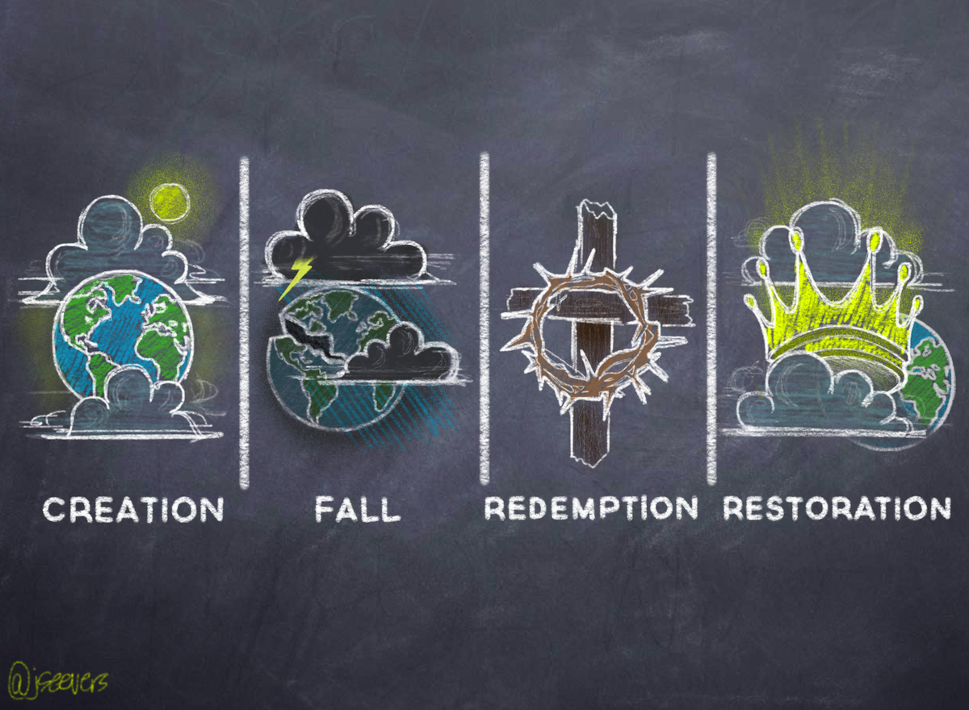
WHY?

Slide 21
3. Hope – Jesus is risen! We can be up where WE BELONG
Jesus’ death and resurrection gives us a hope which is certain, living and eternal.
Sin forgiven
Eternity with Him.

Slide 22
3. Hope – Jesus is risen! We can be up where WE BELONG
1 Peter 3:5
Praise be to the God and Father of our Lord Jesus Christ! In his great mercy he has given us new birth into a living hope through the resurrection of Jesus Christ from the dead, ⁴ and into an inheritance that can never perish, spoil or fade. This inheritance is kept in heaven for you, ⁵ who through faith are shielded by God’s power until the coming of the salvation that is ready to be revealed in the last time.

Slide 23
You accept the history.
You accept the theology.
You accept the hope which comes because He rose again.
But..

Slide 24
Do you Celebrate in a life of victory?

Slide 25
4. Celebration – Jesus is risen! I am up where I BELONG
Are you struggling with addictions?
Are you living a life where there is little evidence of the Spirit’s fruits (love, joy, peace, forbearance, kindness…..)?
Do you battle to spend time with God in prayer, in study?
…………

Slide 26
4. Celebration – Jesus is risen! I am up where I BELONG
Who is “god” in my life?

Slide 27
4. Celebration – Jesus is risen! I am up where I BELONG
The current “god” has to die.
Colossians 2:6-7
As you accepted Christ Jesus as your Lord, you must continue to follow him. Let your roots grow down into him, and let your lives be built on him.

